Slide 1
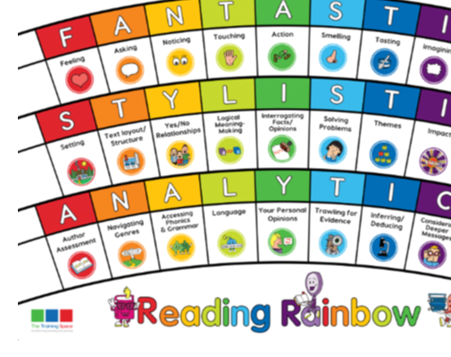
Monday 28th September
Lesson 1:
BOOK TALK

Slide 2
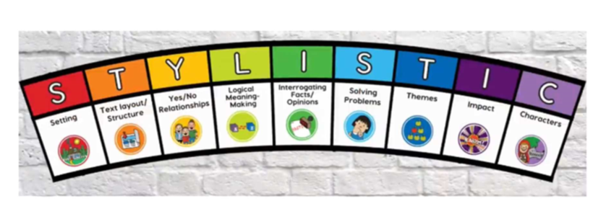
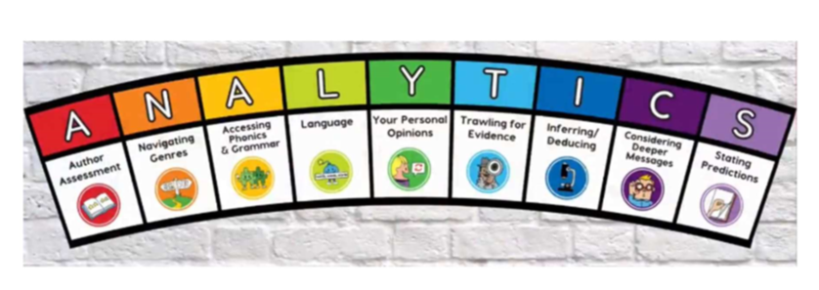
How will our weekly lessons work?
In a week, we have 3 lessons.
Lesson 1: Book Talk (in groups/as a whole class, discussing a text).
Lesson 2: Model (working together to answer questions).
Lesson 3: Enable (Your turn! Using our ideas/sentence starters to answer your own questions).

Slide 3
Lesson 1: Book Talk
During this session, 1 lens from each of the 3 tiers of our Reading Rainbow will have been used.
Today we will be working as a whole class. (Other times you might be in groups or pairs.)
We will be using an extract from our class book, Deadman’s Cove. (Sometimes we will use other types of fiction, non-fiction or poetry.)

Slide 4
1) FANTASTICs: Today the lens we are focusing on is… NOTICING
Seeing this moment through Laura’s eyes, what is her viewpoint on Tariq’s bruises and his reaction?
Together, read through the extract.
Read back through it again with your partner. This time, underline any vocabulary that shows key moments/things that Laura is ‘noticing’.
You have 5 minutes!

Slide 5
NOTICING
With your partner, share your answers to the question using the sentence starters before we discuss as a class.
Seeing this moment through Laura’s eyes, what is her viewpoint on Tariq’s bruises and his reaction?
As a reader, we can see that Laura…
The author creates a powerful image in our minds by…
Challenge: The observations made by Laura are…
Example: As a reader, we can see that Laura notices Tariq’s bruises and immediately feels suspicious when it says she ‘cried’ out to him.

Slide 6
2) STYLISTICs: Our next lens is… IMPACT
Every text is meant to have an ‘impact’ on a reader in some way. It might be to amuse, horrify or persuade you to think something!
Read back through the text again with your partner. This time, underline any vocabulary that has an impact on you – think about anything that makes you feel a certain way. E.g. distressed or uncomfortable.
You have 5 minutes!

Slide 7
STYLISTICS
Share your findings with your partner, and then the class, using the sentence starters below.
Try to use quotes from the extract to support your answer.
The most powerful part of the extract was… because…
The impact of this bit of the story is…
The extract impacts my own feelings because…
Example: The impact of this bit of the story is that it makes you feel Laura’s deep concern for Tariq’s safety. His reaction to quickly hiding the bruises makes you feel even more suspicious and worried.

Slide 8
3)ANALYTICs: Today the lens we are focusing on is… Inferring
In the extract, what hints are there that something sinister is happening involving Tariq and Mrs Mukhtar?
Skim through the text.
Identify any evidence in the text that leads you to infer that Tariq may be being harmed.
You have 5 minutes!

Slide 9
Inferring
In the extract, what hints are there that something sinister is happening involving Tariq and Mrs Mukhtar?
This quote ‘__________________’ leads us to think that… because…
The sentence ‘_______________’ is evidence for…
Challenge: We can make an assumption that…because…
Example: The quote ‘she gave Laura one of her special white smiles that never quite reached her eyes’ leads us to think that there could be something more going on behind closed doors that she is not willing to reveal.

