Slide 1
Year 5 LI to round up to 100,000s
Year 6 LI to round numbers.
In Focus:
Complete this table on your sheets and glue into your book:
Start number | Nearest 10 | Nearest 100 | Nearest 1,000
574
1,245
3,449
 | 4,560

Slide 2
Year 5 LI to round within 10, 100 & 1,000.
Year 6 LI to round numbers.
In Focus:
Complete this table on your sheets and glue into your book:
Start number | Nearest 10 | Nearest 100 | Nearest 1,000
574 | 570 | 600 | 1,000
1,245 | 1,250 | 1,200 | 1,000
3,449 | 3,450 | 3,400 | 3,000
4,555 – 4,564 | 4,560 | 4,600 | 5,000

Slide 3
Learning Objective: To round to the nearest 1000
Which thousand is the following number nearest to?
3467
3000
4000
2000
3000

Slide 4
Learning Objective: To round to the nearest 1000
Which thousand is the following number nearest to?
3748
3000
4000
3000
4000

Slide 5
Learning Objective: To round to the nearest 1000
Which thousand is the following number nearest to?
8097
8000
9000
4000
5000

Slide 6
Learning Objective: To round to the nearest 1000
Which thousand is the following number nearest to?
9711
9000
10,000
3000
4000

Slide 7
Learning Objective: To round to the nearest 1000
Which thousand is the following number nearest to?
3478
3000
4000
7000
8000

Slide 8
Which multiples of 10,000 does this number fall between?
46,000
Which multiples of 100,000 does this number fall between?
260,000
Which multiples of 1,000,000 does this number fall between?
7,900,000

Slide 9
Which multiples of 10,000 does this number fall between?
40,000
50,000
46,000
Which multiples of 100,000 does this number fall between?
200,000
300,000
260,000
Which multiples of 1,000,000 does this number fall between?
7,000,000
7,900,000
8,000,000

Slide 10
Use the digit cards below to make 4-digit numbers to complete the table.
4
2
7
5
Number | Rounded to the nearest 100 is
 | 4,700
 | Seven thousand, three hundred.
 | Five thousand, five hundred.

Slide 11
Use the digit cards below to make 4-digit numbers to complete the table.
4
2
7
5
Number | Rounded to the nearest 100 is
4,725 | 4,700
7,254 | Seven thousand, three hundred.
5,472 | Five thousand, five hundred.

Slide 12
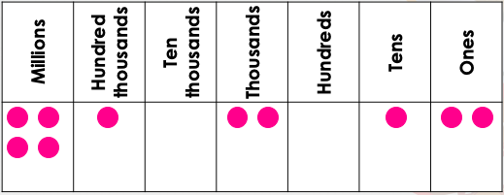
Which two numbers will round to the same value when
rounded to the nearest 10,000?
A
B
4,135,002
Four million, ninety-nine thousand, one hundred and three
C

Slide 13
Which two numbers will round to the same value when
rounded to the nearest 10,000?
A
4,102,012
4,099,103
B
4,135,002
Four million, ninety-nine thousand, one hundred and three
C

Slide 14
Which two numbers will round to the same value when
rounded to the nearest 10,000?
A
4,102,012
4,100,000
4,099,103
B
4,135,002
Four million, ninety-nine thousand, one hundred and three
C
4,140,000
4,100,000

