Slide 1
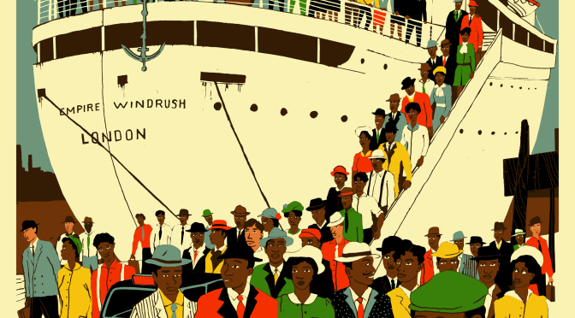
What was Britain like?
LI: To identify human and physical features of a place

Slide 2
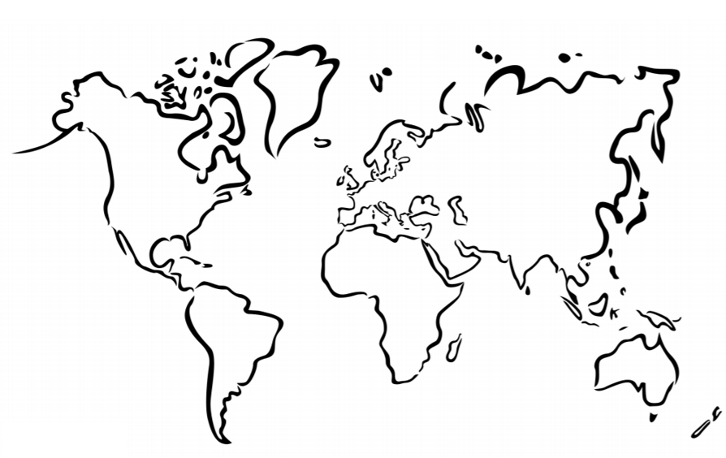
Starter
Label the continents of the world

Slide 3
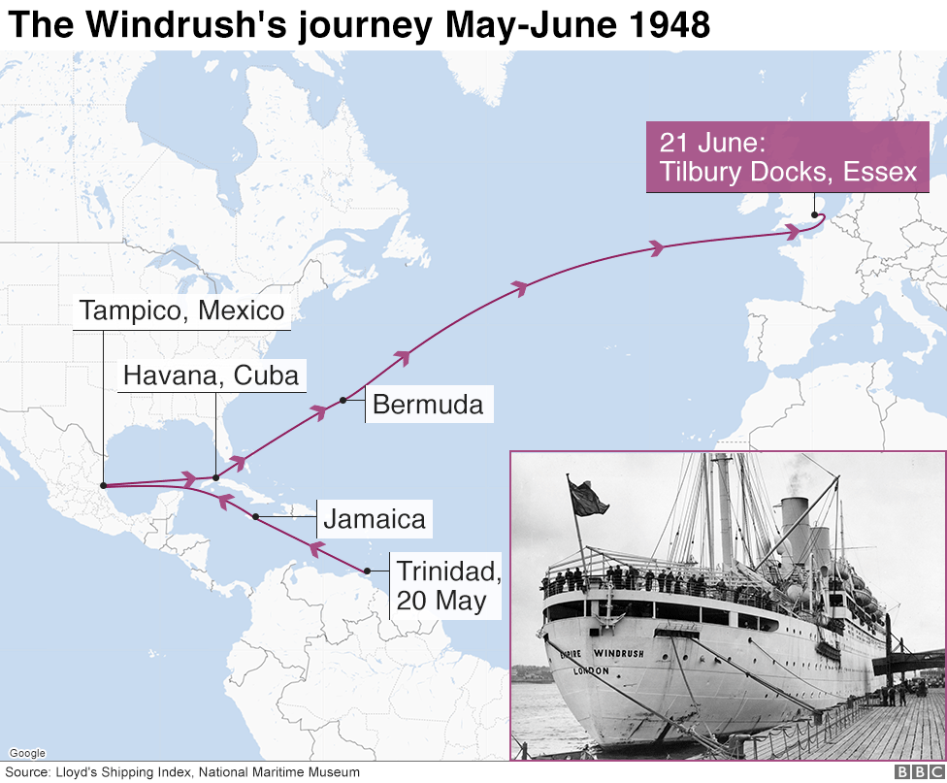
Travelling from the Caribbean
The passengers were on the ship for a month!
- How do you think they felt?
- What do you think it was like being on the ship for a long period of time?
Notes:
Teacher notes:
Help children to identify the Caribbean on a world map and observe the distance from there to London.
Opportunity to ask pupils if any of them have visited the Caribbean and discuss how long it takes to travel.

Slide 4
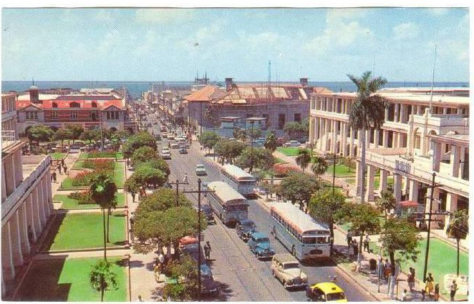
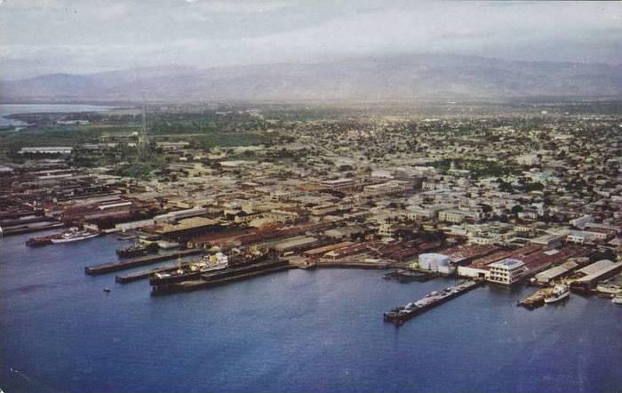
What was the Caribbean like?
What human features can you see?
What physical features can you see?
Notes:
Teacher notes:
Have pictures printed for children to observe and discuss the features.
Teachers use opportunity to address any misconceptions about the Caribbean e.g. negative portrays from the media, showing people in the Caribbean as poor.

Slide 5
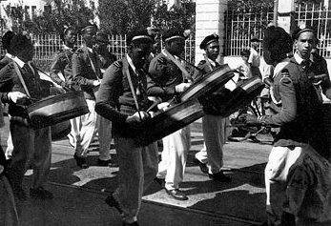
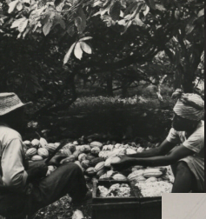
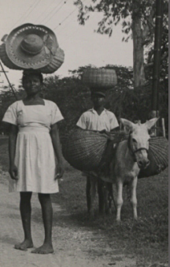
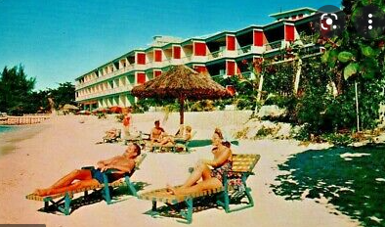
What was the Caribbean like?
What human features can you see?
What physical features can you see?
Notes:
Teacher notes:
Have pictures printed for children to observe and discuss the features.
Teachers use opportunity to address any misconceptions about the Caribbean e.g. negative portrays from the media, showing people in the Caribbean as poor.

Slide 6
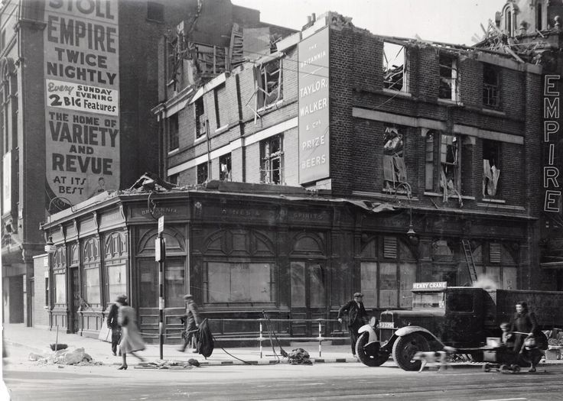
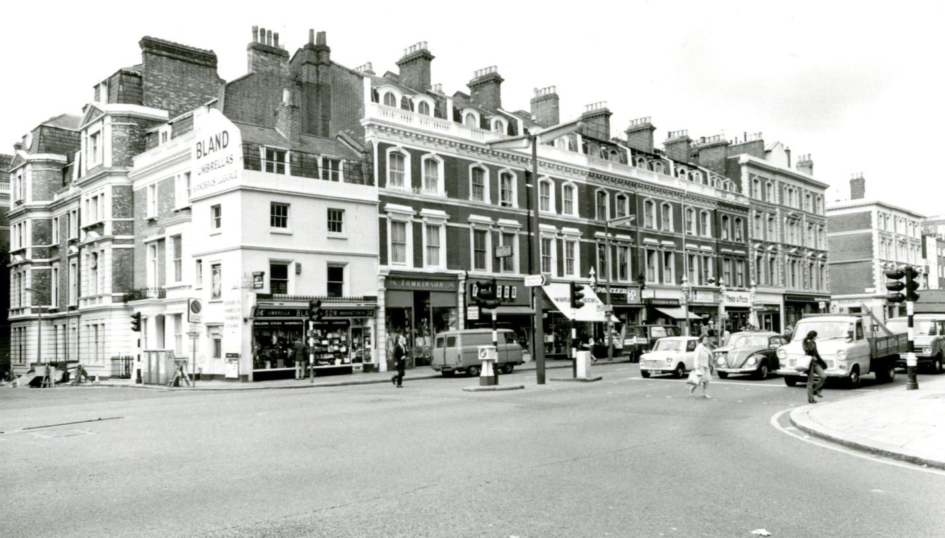
What was Britain like?
What human features can you see?
What physical features can you see?
Notes:
Teacher notes:
- Photo A is Notting Hill and photo B is Hackney (can include images to represent local area)
Have pictures printed for children to observe and discuss the features.
Key question – how do you think the Windrush Generation felt when they saw London?

Slide 7
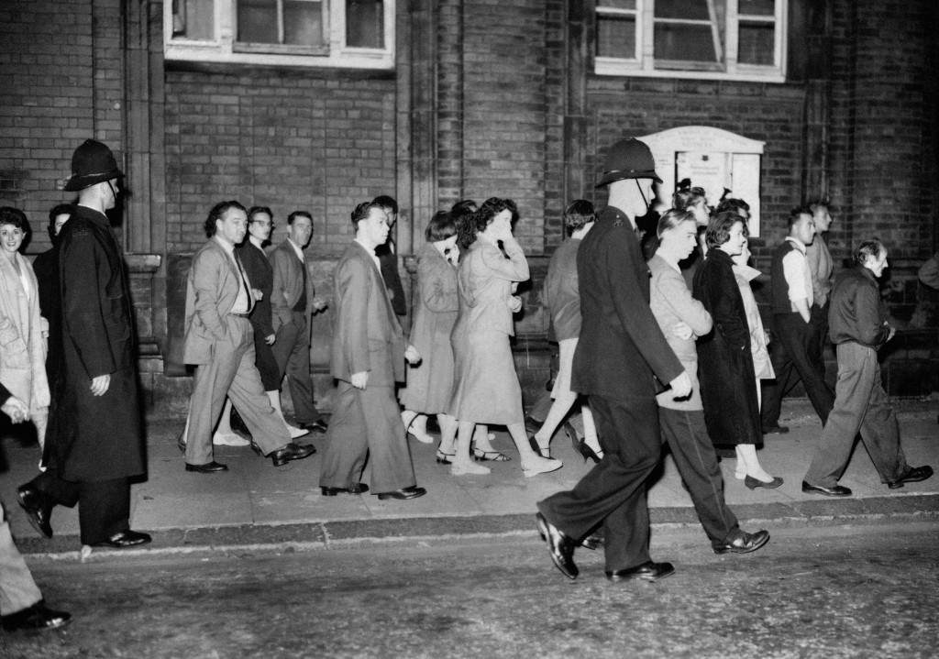
Notting Hill
During the 1940s-50s, the Notting Hill area had a high population of White British people.
Many people from the Windrush Generation settled in this area and they were the majority of black people during this time.
Though they had been invited to come to London, they faced racism in the Notting Hill area and other areas in London.
Notes:
Key questions:
- How do you think the Windrush Generation felt when they realised they were the only blacks?
What do you think they did?
How is this different to the demographics in Jamaica?

Slide 8
What are the similarities and differences?

Slide 9
Activity
What did people have to face when they arrived in Britain?
How would they have felt?
Notes:
Teacher notes:
Once children have compared the two places, they can create a postcard for a place in the Caribbean encouraging others to visit. This can be a great opportunity for children to combat negative views of the country.

Slide 10
Activity
Look at the pictures of the Caribbean and Britain.
What are the similar features?
What differences are there between the two places?
Label the human and physical features of the different places.
Also include the population differences.
Notes:
Teacher notes:
Once children have compared the two places, they can create a postcard for a place in the Caribbean encouraging others to visit. This can be a great opportunity for children to combat negative views of the country.

Slide 11
Further Research
When teaching this lesson, it is important that children are aware that the Windrush Generation were not the first group of black migrants to settle in Britain. History shows that there were black people during earlier periods in history such as the Victorian and Tudor eras.
Nonetheless, after WWII many areas in London had predominate demographics of White British people. Thus, when the Windrush Generation settled in these places, they were seen as outcast.
A great point to highlight to children when teaching is that, the Windrush Generation had moved from a country where they were the predominate race to another country where they became a minority.

