Slide 1
2 2 .2 . 2 2
6: Can I measure angles with a protractor?
I can identify acute, obtuse and right angles.
I can identify the outer and inner scale.
I can identify straight and reflex angles.
In focus task

Slide 2
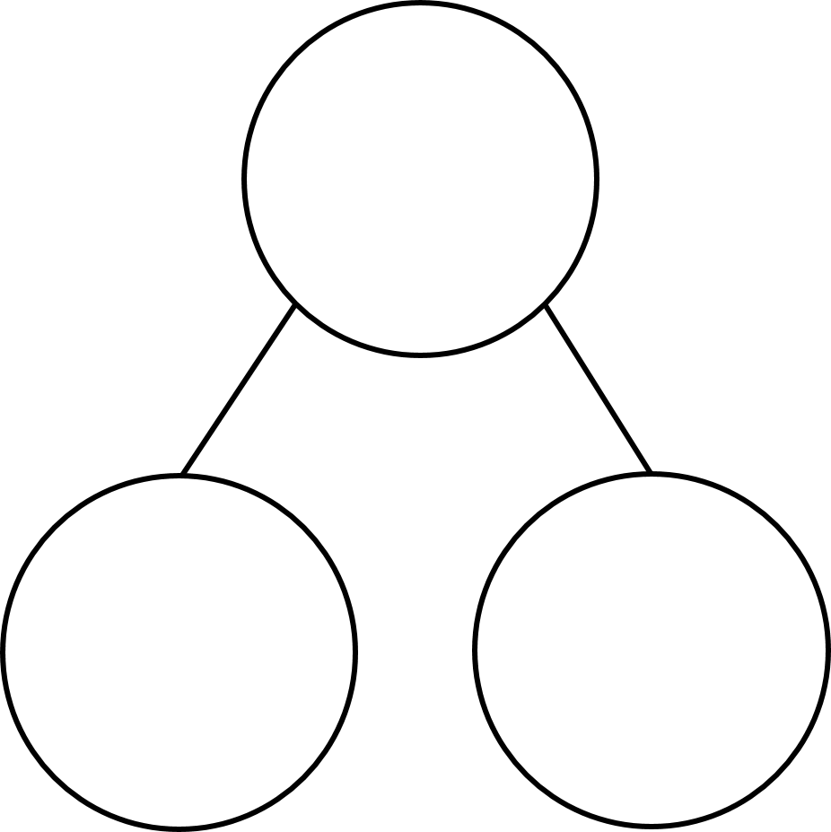

In focus
137 $+$ ____ $=$ 180
180 $−$ ____ $=$ 34
Complete the part-whole models.
180
360
318
27
166
42

Slide 3
In focus
43
137 $+$ ____ $=$ 180
180 $−$ ____ $=$ 34
Complete the part-whole models.
146
180
360
318
360
27
153
194
166
42

Slide 4
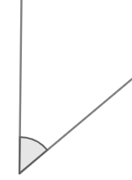
New learning
An angle is a measure of the amount of turn between two lines

Slide 5
New learning
Which line has turned the most?
Have a think

Slide 6
New learning
Which line has turned the most?
Have a think

Slide 7
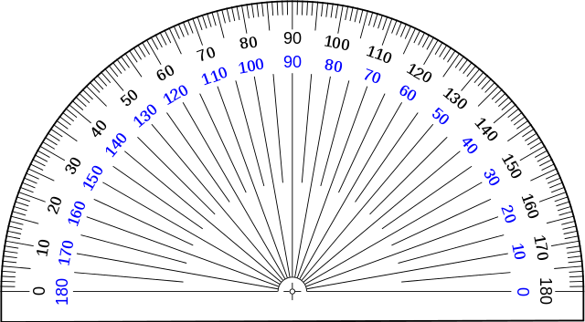
New learning
This is a protractor.
We can use it to measure the degrees of turn between two lines.

Slide 8
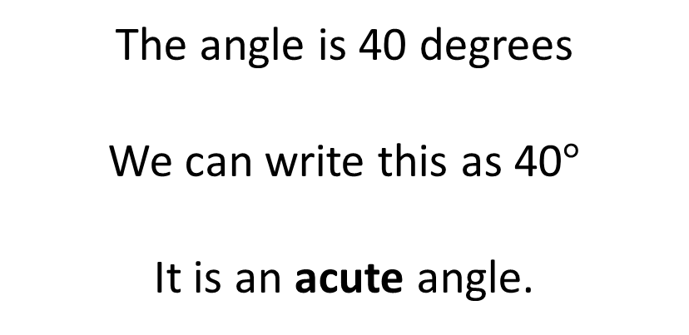
New learning
Outer scale
Inner scale
The angle is 40 degrees
We can write this as 40$°$
It is an acute angle.

Slide 9
New learning
The angle is 88$°$
It is an acute angle.

Slide 10
New learning
The angle is 90$°$
It is a right angle.
The angle is 140$°$
It is an obtuse angle.

Slide 11
New learning
The angle is 180$°$
It is a straight angle.

Slide 12
New learning
180$°$ $+$ 40$°$ $=$ 220$°$
It is a reflex angle.

Slide 13
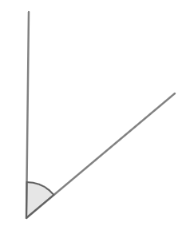
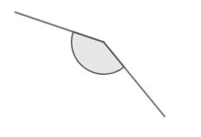
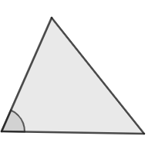
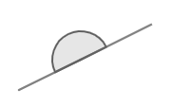
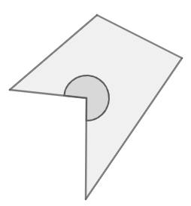
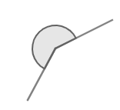
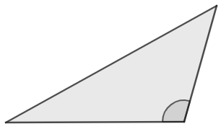
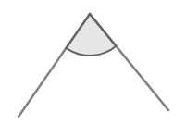
New learning
Are the angles acute, obtuse, straight or reflex?
Have a think

Slide 14
New learning
Acute angle
Obtuse angle
Straight angle
Reflex angle

Slide 15
Develop learning
This the origin, we place this on the vertex where two lines meet.

Slide 16
Develop learning
The baseline is placed on one of the lines

Slide 17
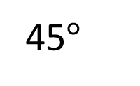
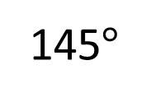
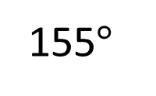
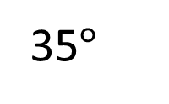
Develop learning
Have a think
What is the size of the angle?
A
B
C
D
155$°$
145$°$
45$°$
35$°$

Slide 18
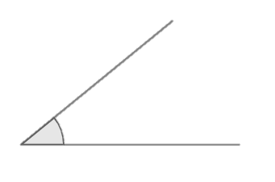
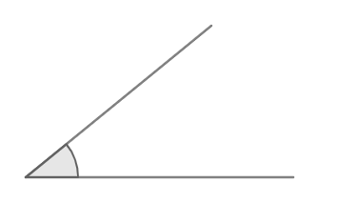
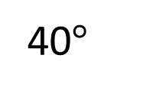
Develop learning
Have a think
40$°$
A
B
C
Which is the greatest angle?

Slide 19
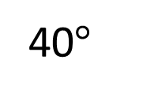
Develop learning
40$°$
40$°$
A
B
C
Which is the greatest angle?

Slide 20
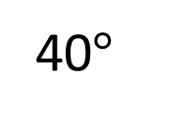
Develop learning
40$°$
40$°$
40$°$
A
B
C
Which is the greatest angle?

Slide 21
Reflection
I felt I was successful using …..
I found it difficult using ….
An effective strategy I used today was ….
Today, it really helped me to use ….
A top tip for ….. is …..
Perhaps it would have been easier if I had used/asked ….

