Slide 1
3 .3 . 2 2
6: Can I draw nets of 3-D shapes?
I know what shape the net will make.
I can draw the nets in different ways.
I can create a 3-D shape out of a net.
In focus task

Slide 2
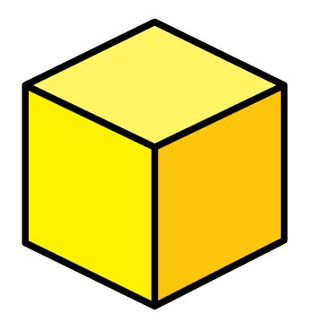
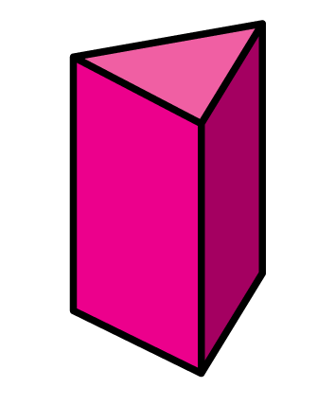
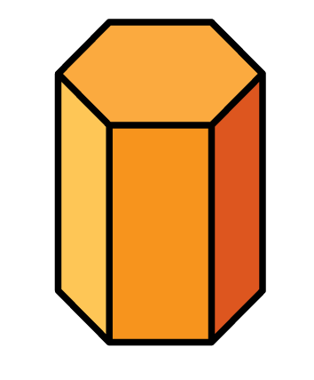
In focus
1)
How many 3-D shapes can you name?

Slide 3
In focus
1)
How many 3-D shapes can you name?
Cone
Cube
Cylinder
Pyramid
(square-based)
Triangular-prism
Hexagonal-prism

Slide 4
New learning
2 dimensions
3 dimensions
Is flat
Has width and length
Is not flat
Has width and length and height

Slide 5
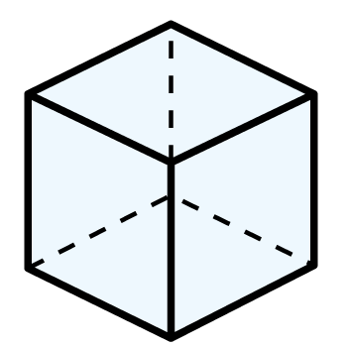
New learning
This is a net of a cube.
A net is a
2-dimensional object.

Slide 6
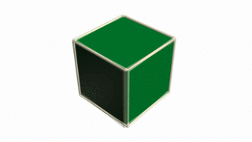
New learning
Edge
2
1
3
5
6
4
Face
6 faces

Slide 7
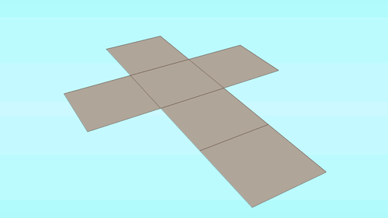
New learning

Slide 8
New learning
Have a think

Slide 9
New learning
What will change?
What will stay the same?
Have a think

Slide 10
New learning

Slide 11
New learning
Will these nets form a cuboid?
Have a think

Slide 12
Develop learning
3 cm
2 cm
4 cm

Slide 13
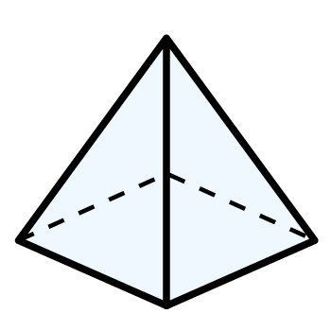
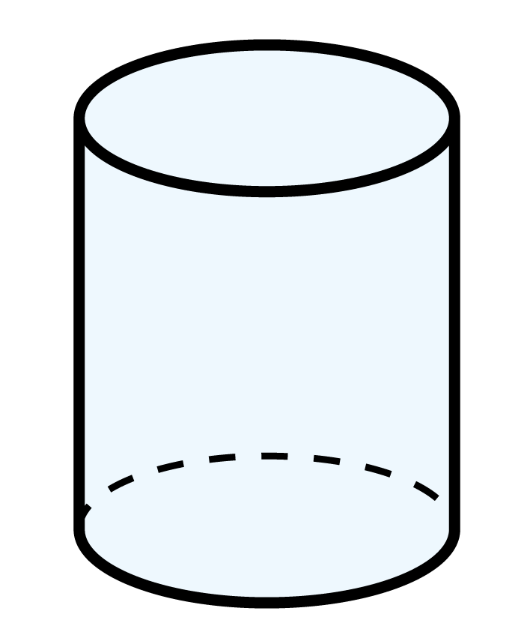
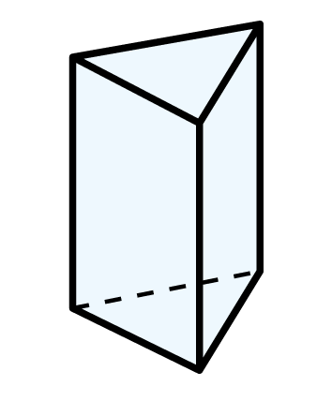
Develop learning
What 3-D shapes will these nets form?
Have a think
Squared-based pyramid
Cylinder
Triangular prism

Slide 14
Light bulb challenge

