Slide 1
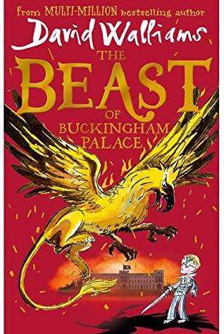
Wednesday 2nd March
RYE WRITERS

Slide 2
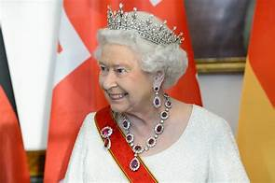
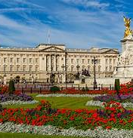
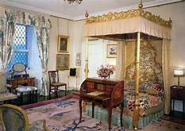
The Beast of Buckingham Palace
It is 2120 and London is in ruins.
The young Prince Alfred has never known a life outside Buckingham Palace – but when strange goings-on breach its walls and stalk the corridors in the dead of night, he is thrust into a world of mystery, adventure and monsters.
And when his mother, the Queen, is dragged away to the Tower of London, Alfred must screw up his courage and battle to save her, himself… and the entire city.

Slide 3
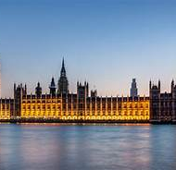
Your task:
The Year 5’s are off to London, to visit the Houses of Parliament.
Today, we will be writing an independent story based on ‘The Beast of Buckingham Palace’… but with a twist!
You are going to create your own adventure story, just like David Walliams, based on the Houses of Parliament!
First, let’s listen to the beginning of the story to get some inspiration.
THE BEAST OF BUCKINGHAM PALACE by David Walliams - Part 1 – YouTube (you can choose how long, but at least 4 minutes!)
As you are listening, make notes of anything you could magpie for your own story on a white board or scrap paper.

Slide 4
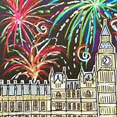
The Houses of Parliament: what is it?
The Houses of Parliament are some of the most important buildings in the UK.
It is here where the main decisions are made on how to run the country – that includes everything from the environment to schools.
It also has one of the most famous landmarks in the world – The Elizabeth Tower. It was completed in 1858 and contains the famous bell – Big Ben!

Slide 5
Story ideas:
You can pick one of these ideas to help you, or use your own idea based on the Houses of Parliament/Year 5 visit.
During the Year 5 visit, a group of children wander off and get caught up in a jewel heist!
The Prime Minister is being held hostage and he NEEDS Year 5’s help!
They discover a message hidden in the last bathroom on the left…you have 2 hours and 20 seconds to rescue the Queen from the Elizabeth Tower before…
Some of the children get distracted by an amazing statue and lose track of the group. As a result they stumble in on a shocking discovery…a mythical beast is being kept locked up in the Houses of Parliament!
One of the Year 5’s befriends a V.I.P inside the Houses of Parliament…fast forward into the future and he/she is running the country! What could go wrong?

Slide 6
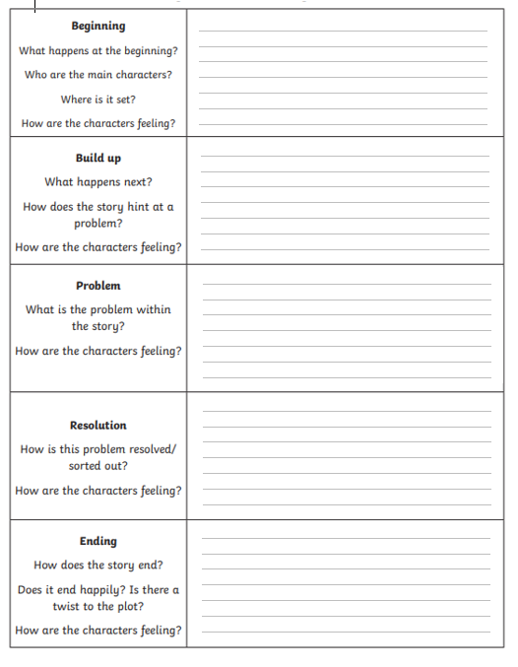
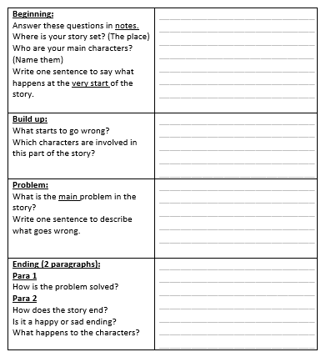
Planning stage:
Ely, Freya, Alsie, Max, Freddie: please use the plan below (and anyone else who would prefer this).
Spend 5-10 minutes maximum planning your story using one of the simple plans on this slide.
Remember – you are not writing your entire story on the planning sheet! Just notes, ideas and vocabulary.
Make sure you have a clear idea of what your story plot is before you start writing. Discuss this with an adult or your buddy next to you.
Learning buddies: check that the person next to you is not writing their whole story onto the planning doc!

Slide 7
Include:
Make sure you include the skills we have looked at, as well as basic writing rules!
Semi colons to join two sentences. ‘We heard a loud creak coming from the basement; we approached it with caution.”
Lots of adjectives and expanded noun phrases! Instead of sad, use petrified, flabbergasted.
Brackets for parenthesis to add more detail. ‘The Queen sat shaking in fear at the top of Elizabeth Tower (the tallest tower in London).’
Subordinating conjunctions e.g. although, since, until, unless, even though.
Fronted adverbials at the start of your sentences – remember the comma!

Slide 8
To help:
Make
Make sure you keep checking if you have included the ‘to include’ list on the slide before.
Use
Use these word mats to help.
Have
Have your thesaurus ready to look up better vocabulary.
Help
Use your spelling mats at the back of your books and your dictionary.

