Slide 1
Monday 9th November 2020
LI: Y5 – draft and write by selecting appropriate grammar and vocabulary.
Y6 – draft and write by selecting appropriate grammar and vocabulary understanding how such choices can change and enhance meaning.­­­­­­

Slide 2
A Victorian Kitchen. What Can you see?

Slide 3
Useful vocabulary
Dresser
Wood fire
Wall Tiles
Stone Floor tiles
Range
Chimney
Copper pots and pans
Copper Kettle
Weighing scales
Jelly moulds
Large saucepan
Iron
What can’t you see?
Fridge
Freezer
Oven
Microwave
Fitted cupboards
Sink
Why not?

Slide 4
Lens 1:
Chotting
Chot down what you can see.
Use adjectives.
Gleaming, copper pans.
Sparkling, clean range.

Slide 5
Share write a sentence to describe what Jim could see.
Jim looked around at the gleaming copper pans spread out along the dresser shelves.

Slide 6
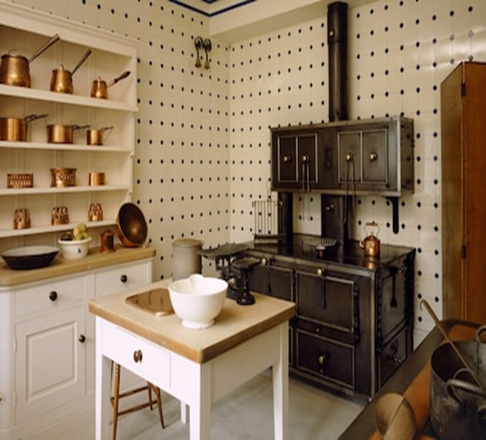
Challenge: Deepen the moment.
Write a sentence to describe what Jim could see when he went inside of the
kitchen using
adjectives.

Slide 7
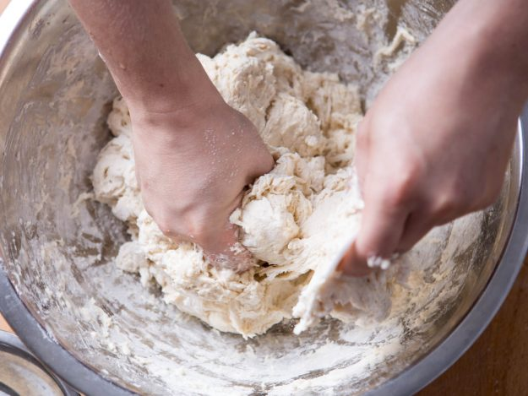
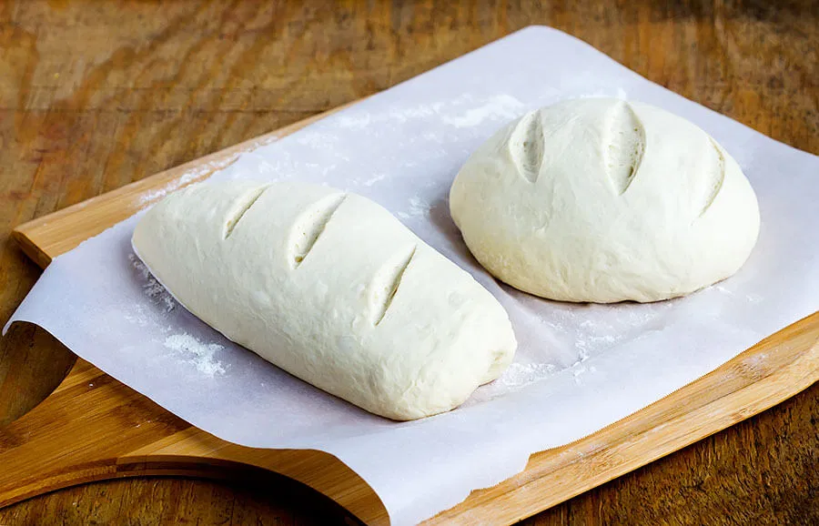
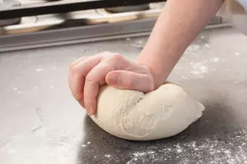
Lens 2:

Slide 8
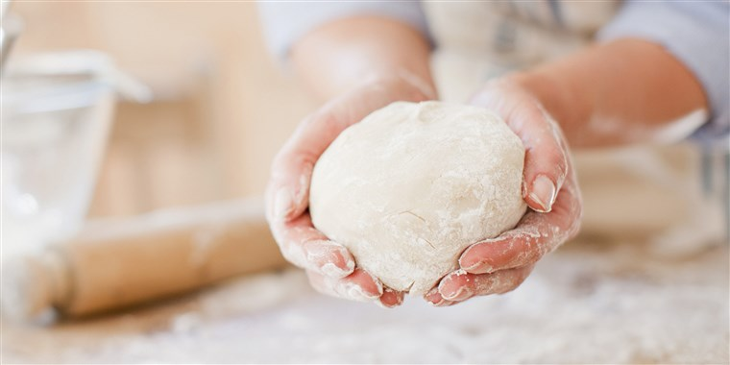
Dough (feel and knead your dough) What does it feel like?
Chot down words to describe how the dough feels.
Smooth, squashy, soft, squidgy, sticky.
Have any of you ever made bread?
What happens when you knead bread dough?

Slide 9
Share write a sentence together to describe Lizzie making the bread. Remember to describe how the bread dough feels.
Lizzie kneaded the dough, sticky at first from the frothing yeast but growing smoother as her firm hands pummelled relentlessly.

Slide 10
Your turn!
Write a sentence about Lizzie kneading the dough, including details about how it felt in her hands.
Challenge- deepen the moment and include a simile.
Her hands pummelled the dough relentlessly like the pistons on a steam train.

Slide 11
CHOT Relieved, scheming, hopeful, pleased. Identify positive and negative ideas.
Rosie says “My dough’s like a boulder”. How might she feel about having a helper in the kitchen to make the bread?
Teacher notes:

Slide 12
Rosie narrowed her eyes thoughtfully. This girl could prove very useful. (Positive intent)
Decide whether Rosie would have positive or negative intent at the thought of having more help in the kitchen (you can choose either). Then share write a sentence describing her inner thoughts.

Slide 13
Decide if Rosie has positive or negative intent and then write a sentence describing her inner thoughts.

