Slide 1
1 2 . 9. 2 1
In focus task

Slide 2
In Focus Task
Band 3/4/5/6
1. Which multiples of 10 is 73 closest to?
2. Which multiples of 100 is 320 closest to?
3. Which multiples of 1000 is 5,678 closest to?
Please lay this out in your book like this:
73 is closest to ___ and ___ .
Alternative:
1. 10, 20, 30, ___, 50, 60, ___, ___, ___, ___.
2. 100, 200, ___, ___, 500, 600, ___, ___, 900, _____.

Slide 3
New Learning
Stem sentence:
If it’s 4 or below we round down.
If it’s 5 or above we round up.

Slide 4
New Learning
Round 37 to the nearest 10.
First, we need to find out which multiples of 10 are closest to 37.
Then, place 37 on the number line.
Count the jumps, is it closer to 30 or 40?

Slide 5
New Learning
Let’s see if we can round 37 to the nearest 100.
First, we need to find which multiples of 100 are closest to 37.
Then, we place 37 on the number line.
Which multiple of 100 is 37 closest to?

Slide 6
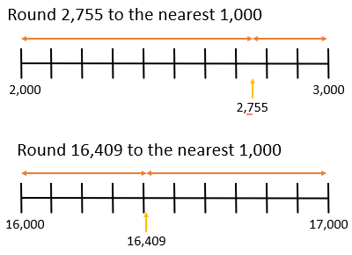
New Learning

Slide 7
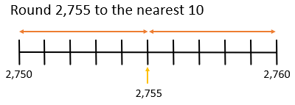
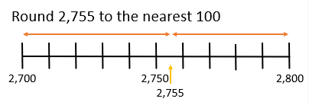
Talk Task
See if you can work out the answers to these in your groups.

Slide 8
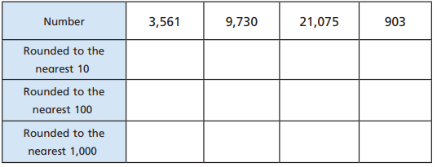
Develop Learning
2,572
8,430
31,572
704

Slide 9
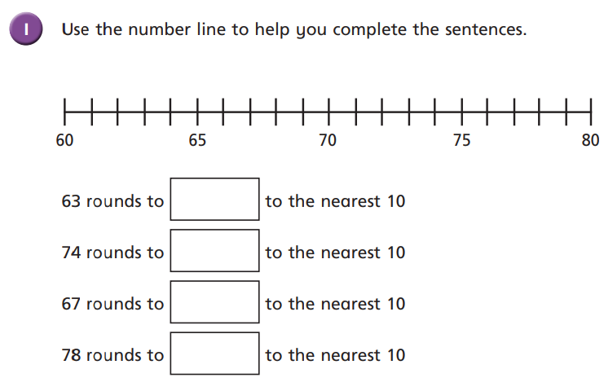
Independent Task
2) Round each number to the nearest 10:
48 248 548 1,748
3) Round each number to the nearest 100:
1,532 1,542 1,552 1,562
4)

Slide 10
Reasoning
Groot thinks that 37 rounded to the nearest 100 is zero.
Is he correct?
Draw a (NEAT!) number line to represent your answer.

Slide 11
Plenary
Light Bulb Challenge
*Remember to answer in full sentences*
It is true because… or It is false because…

Slide 12
Plenary
Light Bulb Challenge
Purple pen, check if you got the correct answer.

