Slide 1
Term 4 Week 1
Geography
Castles

Slide 2
Learning Intention
L.I: To name and locate the capital cities of the UK and their castles.
S.C:
I can identify the UK and its countries and capital cities on a map.
I can explore the castles in each capital city and identify the geographical features they have been built on or near.

Slide 15
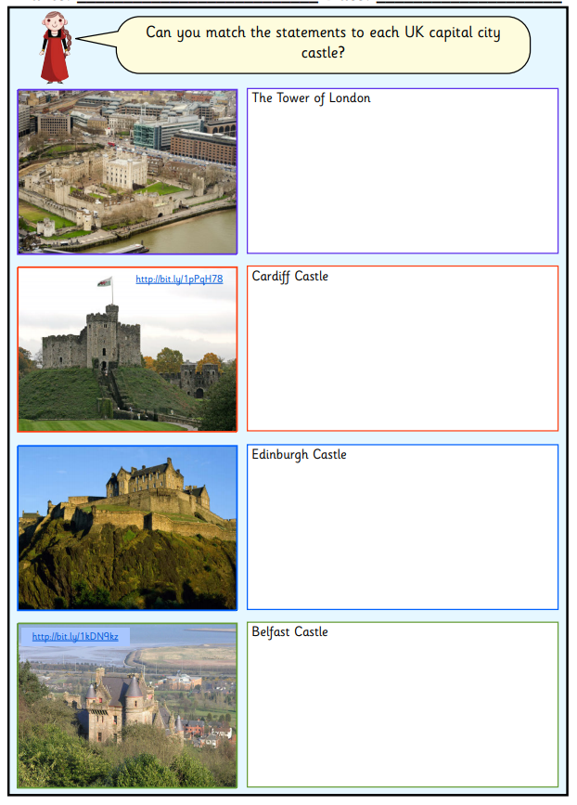
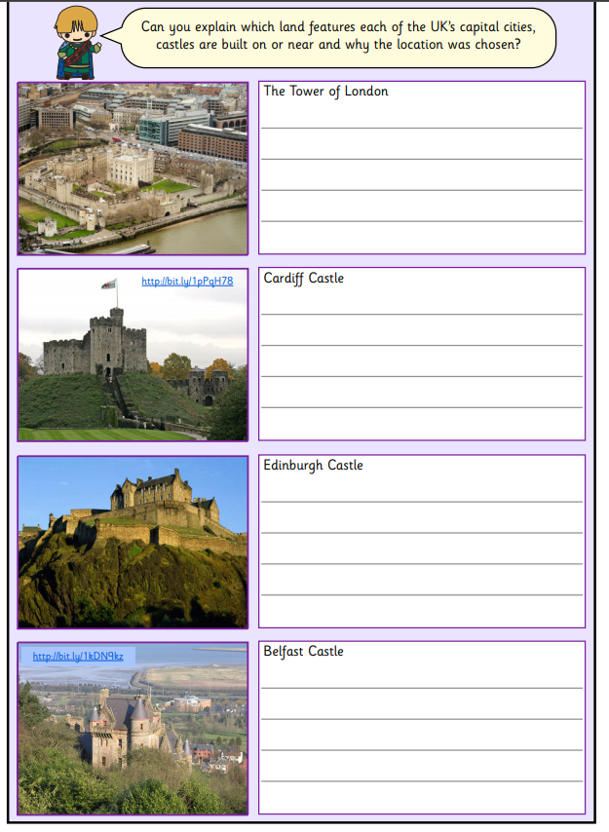
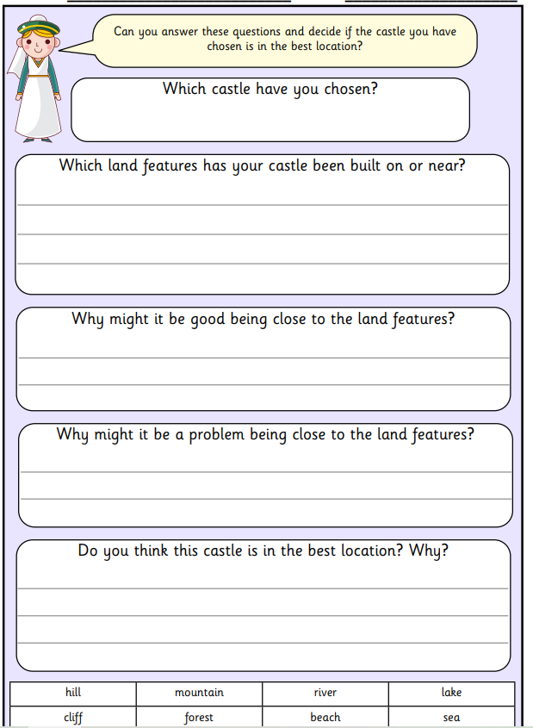
Task To write which of the land features each of the UK’s capital cities, castles are built on or near.

