Slide 1
Term 4 Week 1 History
L.I: To find out about UK castles that were built by the Normans.
SC: I can identify and name ‘motte and bailey’ castles and ‘keep and bailey’ castles.
I can find similarities and differences between the castles.
I can explain why castles were important for the Norman invaders.

Slide 2
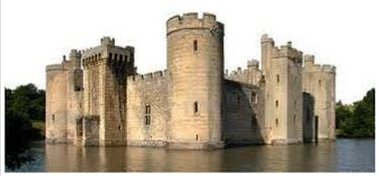
Castles
Today we will be... Finding out about UK castles that were built by the Normans.

Slide 3
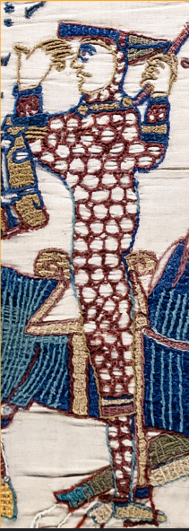
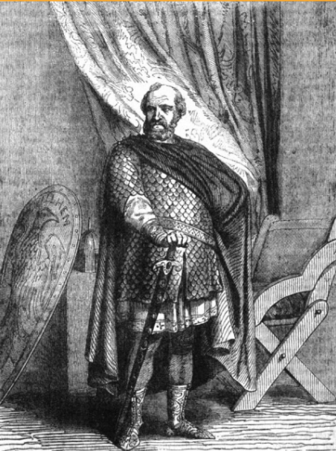
Do you know who this is?
What did he do?

Slide 4
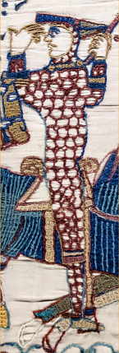
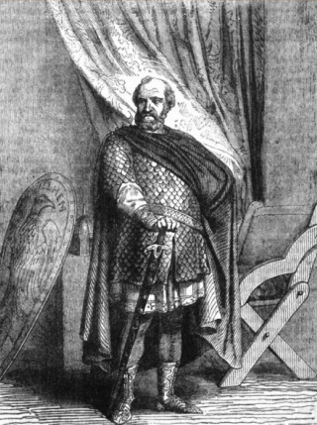
He is William the Conqueror. He fought in the Battle of Hastings and won. This meant he became king of England.
Most of the English were not happy about William being their king.

Slide 5
Lots of people rebelled against William. This means they fought his armies, refused to pay him money or follow his laws.
What do you think William did about this?

Slide 6
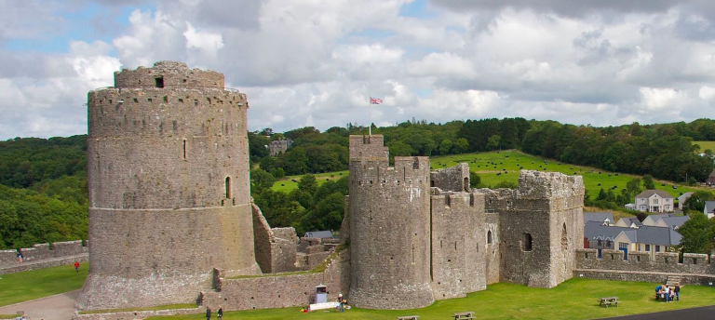
William decided to send his army to stop the rebellions. He built castles to show how powerful he was and to keep his soldiers safe.
The castles reminded people they would be in trouble if they rebelled.

Slide 7
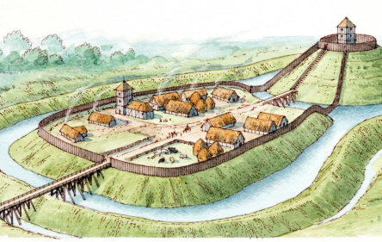
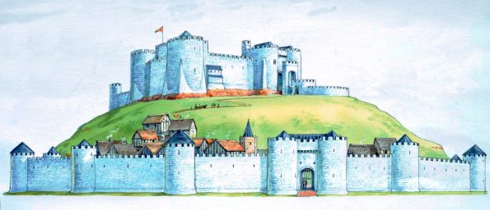
William built two different types of castle.
Which castle would be easier to build? Which would be easier to defend?

Slide 8
The Normans built wooden castles first because they were quick to build. This type of castle is a motte and bailey. The wooden fort was built on a motte. A motte is a mound. The army lived in the bailey.
Can you think of any problems with having a wooden castle?

Slide 9
The wood would rot when it got wet. This meant the castle had to be rebuilt and repaired. Wood can also catch fire so it was vulnerable to attack.

Slide 10
When most of the English rebelling had stopped, the Normans began building stone castles. They are called keep and bailey.
The keep is the stone castle. The bailey is where the soldiers lived. They would go into the castle if they were under attack.

Slide 11
These stone castles took much longer to build than the wooden castles. The walls were five metres thick!

Slide 12
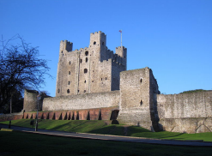
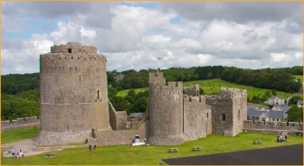
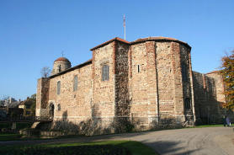
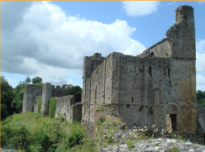
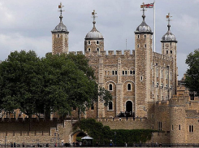
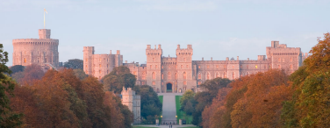
Do you recognise any of these castles? They were all built by the Normans, but have been changed and had sections added to them by several people since then.

Slide 13
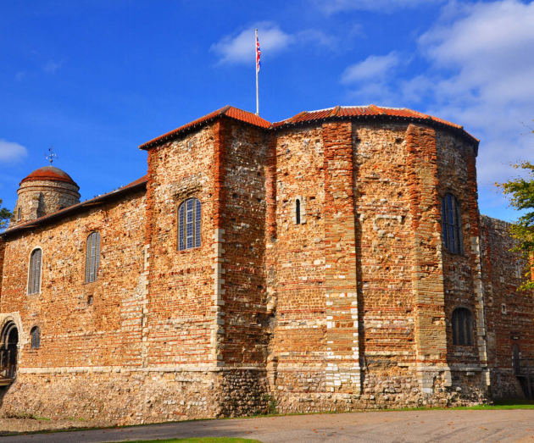
This is Colchester Castle. It is in England. The Normans started to build it in 1069. It was built on the foundations of a Roman temple.

Slide 14
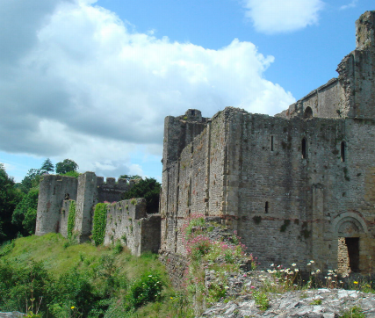
This is Chepstow Castle. It is in Monmouthshire, Wales. The Normans started to build it in 1067. The castle is now in ruins.

Slide 15
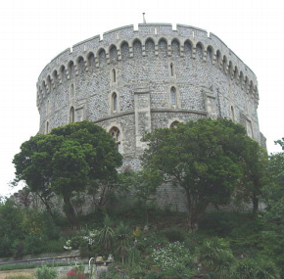
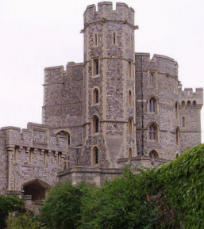
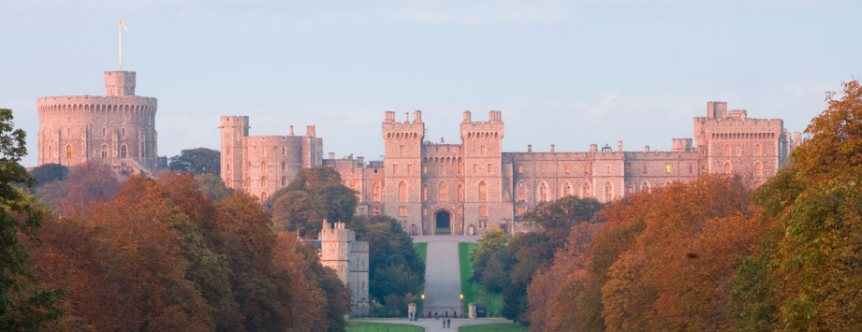
This is Windsor Castle. It is in England. The Normans started to build it around 1070. It is still a royal residence.

Slide 16
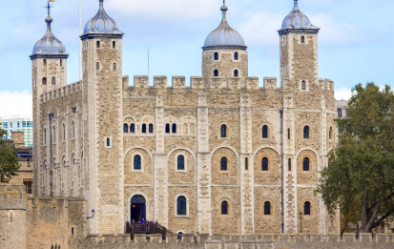
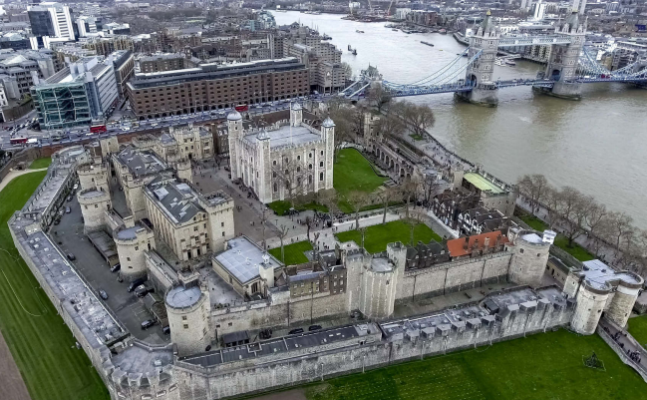
This castle is the Tower of London. It is in England. The Normans started building it in 1078.
The official name of this building is Her Majesty's Royal Palace and Fortress, The Tower of London.

Slide 17
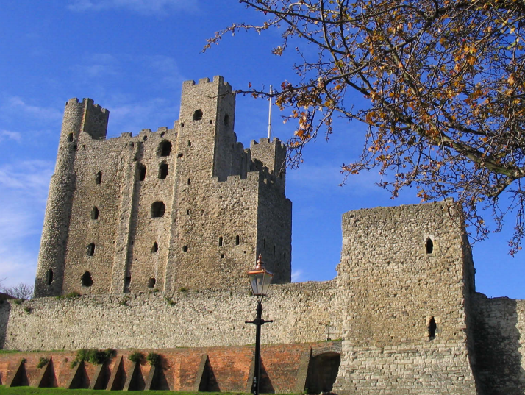
This is Rochester Castle. It is in Kent, England. The Normans started to build it in about 1087.

Slide 18
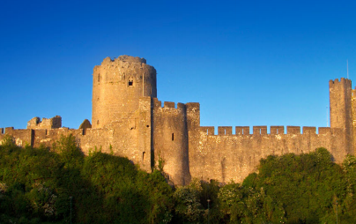
This is Pembroke Castle. It is in west Wales. It was built in 1093. In 1189 the Normans turned the wooden fort into this stone castle.

Slide 19
What do you think it would have been like living in England when William the Conquerer was king?

Slide 20
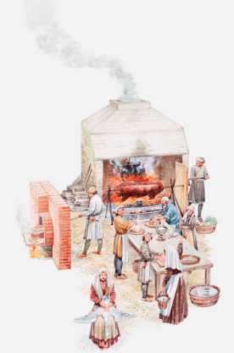
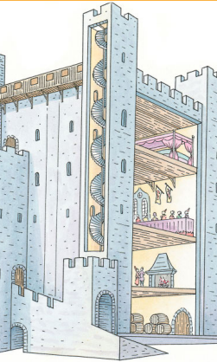
This is the castle kitchen. Can you name anything that is cooking?
This is a cross-section of a castle. Can you spot the spiral staircase?
If you lived in a castle you probably had a bed to sleep in and a roof to keep off the rain. You would normally have enough food to eat. Unfortunately the castle would often be attacked and need defending.

Slide 21
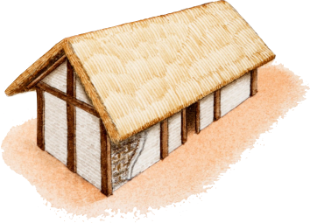
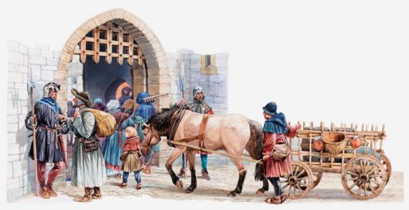
If you lived in a village near a castle you probably lived in a house that was owned by the lord. The house had one room for eating, cooking and sleeping. You kept your animals inside your house during the night. You had to pay taxes to the lord and if an army came to attack the castle they would generally burn the village down.
This is a typical medieval house. It is made with wattle (twigs) and daub (clay and straw).
These villagers are bringing their goods to sell at market. They are going into the castle grounds, through the gate. Can you spot the guards?

Slide 22
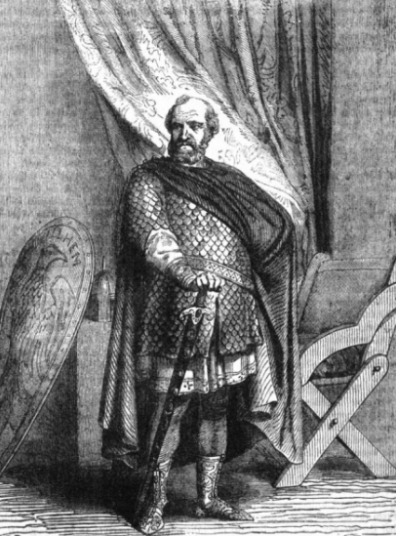
Would you like to have lived in Norman England?

Slide 23
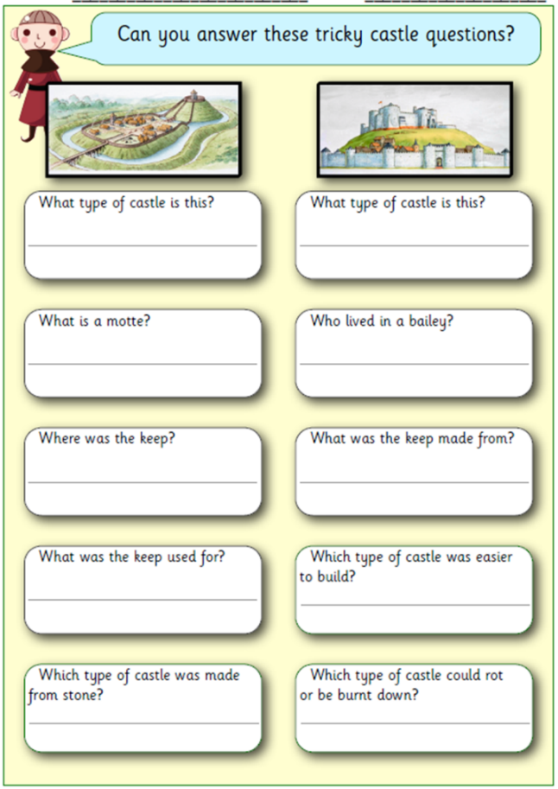
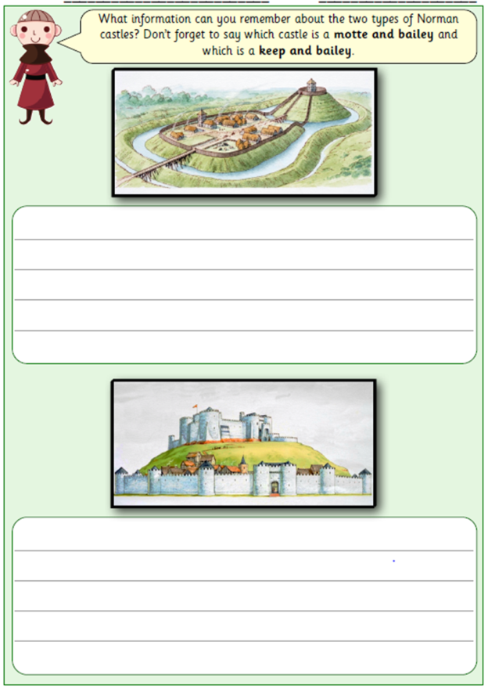
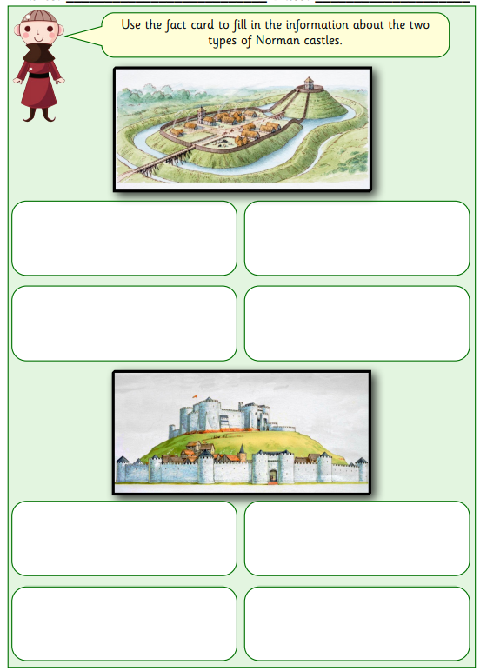
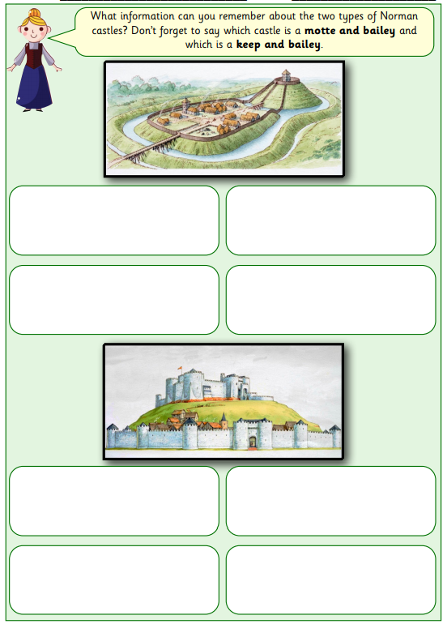
Tasks:
Use today’s learning to write facts about the two different types of Norman
castles.
Extension. Answer the questions about the castles.

